Slide 1
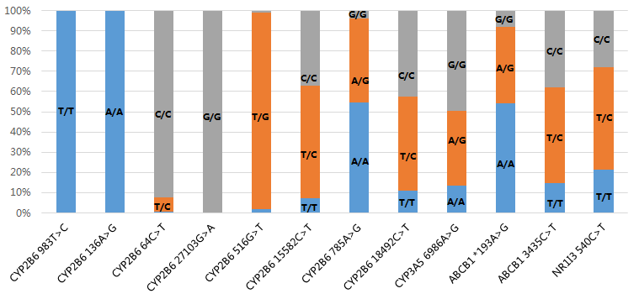
Pharmacogenomics and Pharmacokinetics of Efavirenz 400mg or 600mg in 184 Treatment-naive HIV-infected Patients in China.
Rong Chen¹, Jun Chen¹, Jingna Xun¹, Zhiliang Hu², Qiong Huang³, Renfang Zhang¹, Corky Steinhart^{4,5}, Yinzhong Shen¹, Li Liu¹, Hongzhou Lu^{*1}
¹ Department of Infection and Immunology, Shanghai Public Health Clinical Center, Fudan University. Shanghai, 201508, China.
²Department of Infectious Disease, the Second Hospital of Nanjing, Nanjing University of Chinese Medicine, Nanjing, 210003, China.
³Yunnan AIDS Care Center (YNACC), Yunnan Provincial Infectious Disease Hospital, Kunming 650500, China
⁴ CAN Community Health, Florida, 34232,USA. ⁵ The University of Central Florida College of Medicine, Florida, 32827, USA.
Poster: PEB0243
Background
Result
Pharmacogenomics and pharmacokinetics data of efavirenz (EFV) have been widely reported. However, these characteristics of a lower dose(400mg) efavirenz has rarely been reported.
Overall, 184 participants (14 women) received at least one dose of TDF+3TC+EFV and were included in the pharmacogenomics analysis(Figure1 , Table1). Allele frequency had no difference between the standard and lower dose groups(Figure2). There was no significant relationship between EFV pharmacogenomics and ADRs of CNS. 171 blood samples were collected for plasma concentration detection. In the standard-dose group, CYP2B6 516G>T T/T(p=0.014) , CYP2B6 785A>G G/G(p<0.001), CYP2B6 18492C>T C/C( p<0.001) and ABCB1 3435C>T T/C(p=0.027) were all associated with higher plasma EFV levels. However, these were not seen in the lower dose group (Figure3). 166 participants received HIV RNA detection at week 48. No relationship was found between pharmacogenomics and antiretroviral efficacy. Persons with a bodyweight < 60 kg had significantly higher EFV C₁₂ compared with those with weight ≥ 60 kg when using 600mg EFV but not 400mg EFV (Table2).
Method
Treatment-naive HIV-Infected patients from 3 sites in China were randomly assigned(1:1) to receive either a lower dose anti-retroviral regimen comprised of TDF (200 mg) plus efavirenz (400 mg) and lamivudine, or the standard dose regimen. Relationships between single nucleotide polymorphisms (SNP: rs28399499, rs35303484, rs8192709, rs36118214, rs3745274, rs4803419, rs2279343, rs2279345, rs776746, rs3842, rs1045642 and rs2307424) and EFV PK with plasma HIV-RNA viral load (pVL), central nervous system (CNS) adverse reactions (ADRs) and efavirenz-associated skin rash were explored at 48 weeks. Blood samples were collected for detection of the mid-dose interval concentration (C₁₂) of EFV at 8 weeks after treatment.
Table 1: Demographics and clinical baseline characteristics
 | Lower dose group(n=92) | Standard dose group(n=92) | Total (n=184)
Men | 83(90.2%) | 87(94.6%) | 170(92.4%)
Age(years) | 31(25-36.5) | 28(25-36) | 30(25-36)
Weight(kg) | 65.0±8.6 | 63.0±9.3 | 64.0±8.9
BMI (kg/m²) | 21.8±2.5 | 21.2±2.6 | 21.5±2.6
Median (IQR) HIV-RNA in log₁₀ copies/mL | 4.4(3.9-4.8) | 4.5(4.2-4.9) | 4.5(4-4.8)
HIV-RNA copies per mL ≥10⁵copies/ml[no. (%)] | 14(15.2%) | 13(14.1%) | 27(14.6%)
Baseline CD4 T cell count (cells/ul) | 310(190-466) | 272(206-376) | 292(199-426)
Figure 2 Proportions of genotypes of 12 SNPs in 184 patients
Conclusion
The effect of pharmacogenomics and body weight on the plasma concentration of EFV was significant in the 600mg group, but not in the 400mg group. The reduced dose of EFV is as good as the standard dose and is safer for people living with HIV.
Acknowledgements
Figure 1 Flow Chat
This study was founded by Shanghai Shenkang Hospital Development Center(No 16CR1018A), National Natural Science Foundation of China (81600480) and 13th Five-year National Major Science and Technology Project (No.2017ZX09304027 and 2017ZX10202101004)
Table2 Plasma concentration of EFV (mg/L) in two groups depending on body eitht
 | Plasma concentration of EFV (mg/L) [median (IQR)]
 | Body weight <60 kg | Body weight ≥60kg | P value
Lower dose group | 1.72(1.50~2.17) | 1.80(1.41~ 2.32) | 0.918
Standard dose group | 3.33(2.28~4.33) | 2.22(1.70~3.08) | 0.005
Figure3 Effects of 4 SNPs with meaningful p-value on EFV plasma concentration. Value are presented as median with inter-quartile range.

